Slide 1
GDP Analysis- Assignment
By- Shikhar

Slide 2
Key terms of Assignment
Understanding GDP:- Gross domestic product (GDP) at current prices is the GDP at the market value of goods and services produced in a country during a year. In other words, GDP measures the 'monetary value of final goods and services produced by a country/state in a given period of time’ .
Per Capita GDP and Income:-Total GDP divided by the population gives the per capita GDP, which roughly measures the average value of goods and services produced per person. The per capita income is closely related to the per capita GDP (though they are not the same). In general, the per capita income increases when the per capita GDP increases, and vice-versa.
Union territory:-A union territory is a type of administrative division in the Republic of India. Unlike the states of India, which have their own governments, union territories are federal territories governed directly by the union government (central government) hence the Union Territory. Chandigarh, Delhi, Dadra and Nagar Haveli, Daman and Diu, Lakshadweep, Andaman and Nicobar Island and Puducherry are the union territory of India.

Slide 3
Data Exploration:-
We have three datasets which are source from https://data.gov.in/, an Open Government Data (OGD) platform of India.
Data I-A:-This dataset consists of the GSDP (Gross State Domestic Product) data for the states and union territories in different time duration. This dataset contains 36 columns.
1st column- Items Description
2nd column- Duration
3rd – 35th column–States od India
36th column- All India GDP.
Data I-B:-This dataset is a group of different states of India. This dataset contains the distribution of GSDP among three sectors: the primary sector (agriculture), the secondary sector (industry) and the tertiary sector (services) along with taxes and subsidies. There is separate dataset for each of the states.
Data II:-This dataset contains the drop rates of 3 different education level- Primary, secondary and senior secondary across different states of India.

Slide 4
Problem Statement:-
As the chief data scientist at NITI Aayog, we have to provide top-level recommendations to the Chief Minister of various state, which will help them priorities areas of development for their respective states. Basically our overall goal is to help the CMs focus on areas that will foster economic development of their respective states.
So, to solve this problem we are focusing on GDP(Gross Domestic Product) of each state of India and based upon this we provide our recommendation to CM.

Slide 5
Data Cleaning and Analysis of Dataset 1-A:-
We identify that in dataset 1-A, state West Bengal has all the null values. So, we drop the West Bengal column from the dataset.
Delete the '(% Growth over the previous year)' and 'GSDP - CURRENT PRICES (` in Crore)' for the year 2016-17 in dataset 1-A.
Drop the column All India GDP from dataset 1-A because we want to analysis only for state of India.
Extract only 2013-14, 2014-15,2015-16 duration rows from the dataset to calculate the average GDP of the states of India.

Slide 6
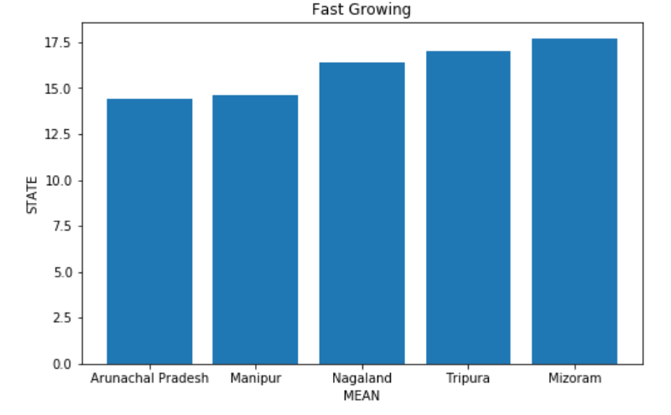
Analysis of average of GDP across different states:-
Fast Growing States(top 5)-
Mizoram-17.70
Tripura-17.03
Nagaland-16.41
Manipur-14.61
Arunachal Pradesh-14.41

Slide 7
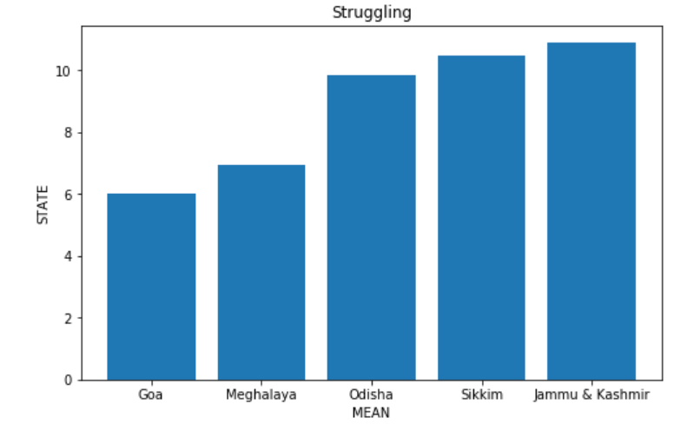
Struggling states(bottom 5)
Jammu & Kashmir-10.90
Sikkim-10.48
Odisha-9.83
Meghalaya-6.95
Goa-6.03

Slide 8
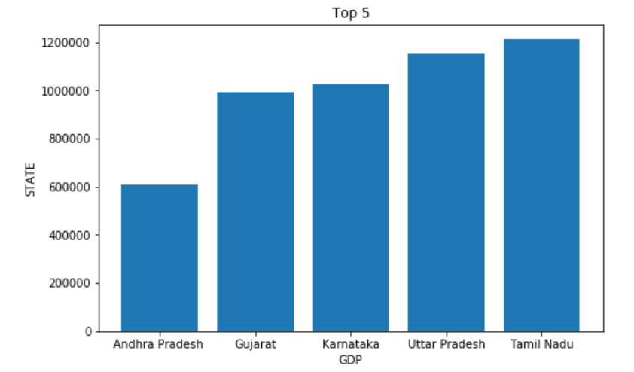
GDP ranking in the year 2015-16:-
Top 5 GDP states in India-
Tamil Nadu
Uttar Pradesh
Karnataka
Gujarat
Andhra Pradesh

Slide 9
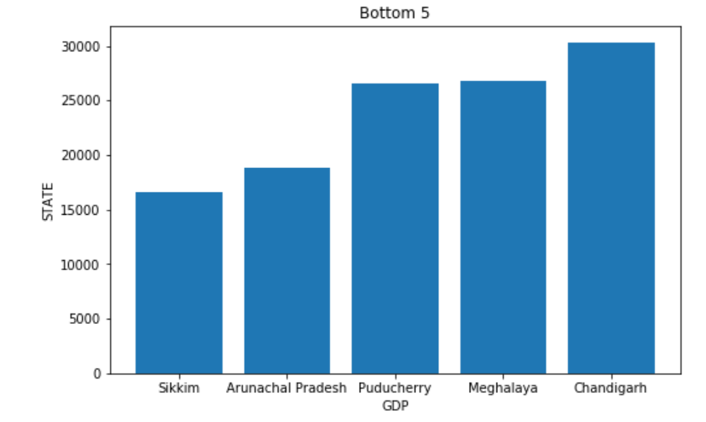
Bottom 5 GDP states of India:-
Chandigarh
Meghalaya
Puducherry
Arunachal Pradesh
Sikkim
We can clearly see the GDP of different states of India in year 2015-16. Presonaly, I belong to Uttar Pradesh which having a good and above average GDP rate in year 2015-16.

Slide 10
Data Cleaning and analysis of Data 1-B:-
Remove the Union territories states from our dataset like Chandigarh, Delhi, Dadra and Nagar Haveli, Daman and Diu, Lakshadweep, Andaman and Nicobar Island and Puducherry because they are governed by central government not state governments.
Merge all the state data in to one file for further analysis.
Extract only duration year 2014-15 data as we just need to analysis this year data.
Now, we are focusing on GDP per capita.
Divide the states in four categories(C1, C2, C3 and C4) with respect to GDP per capita.
85th -100th percentile -> C1
50th -85th percentile -> C2
25th -50th percentile -> C3
0th – 25th percentile -> C4

Slide 11
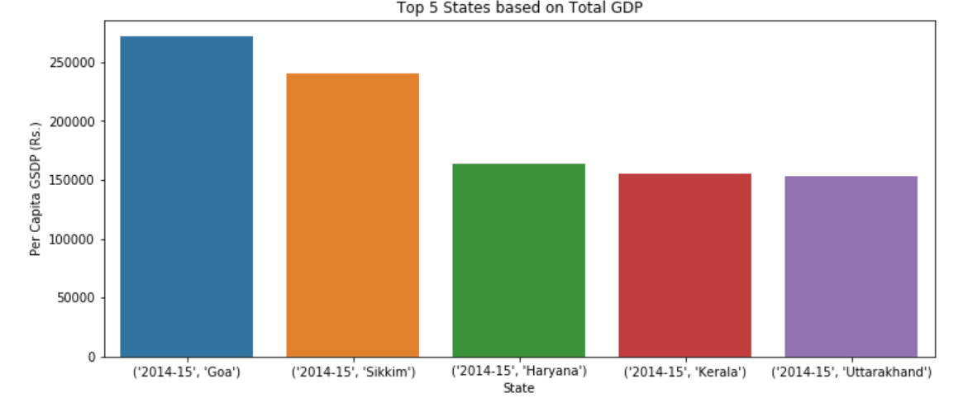
GDP per Capita of different states of India:-
Top 5 states of India based upon GDP per capita:-
Goa
Sikkim
Haryana
Kerala
Uttarakhand

Slide 12
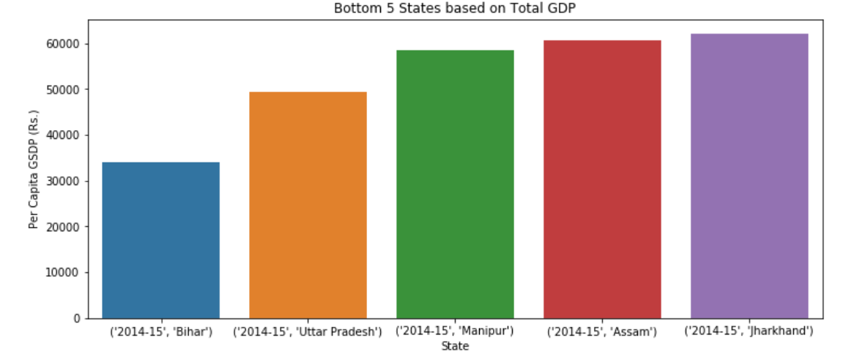
Bottom 5 states of India based upon GDP per capita:-
Jharkhand
Assam
Manipur
Uttar Pradesh
Bihar

Slide 13
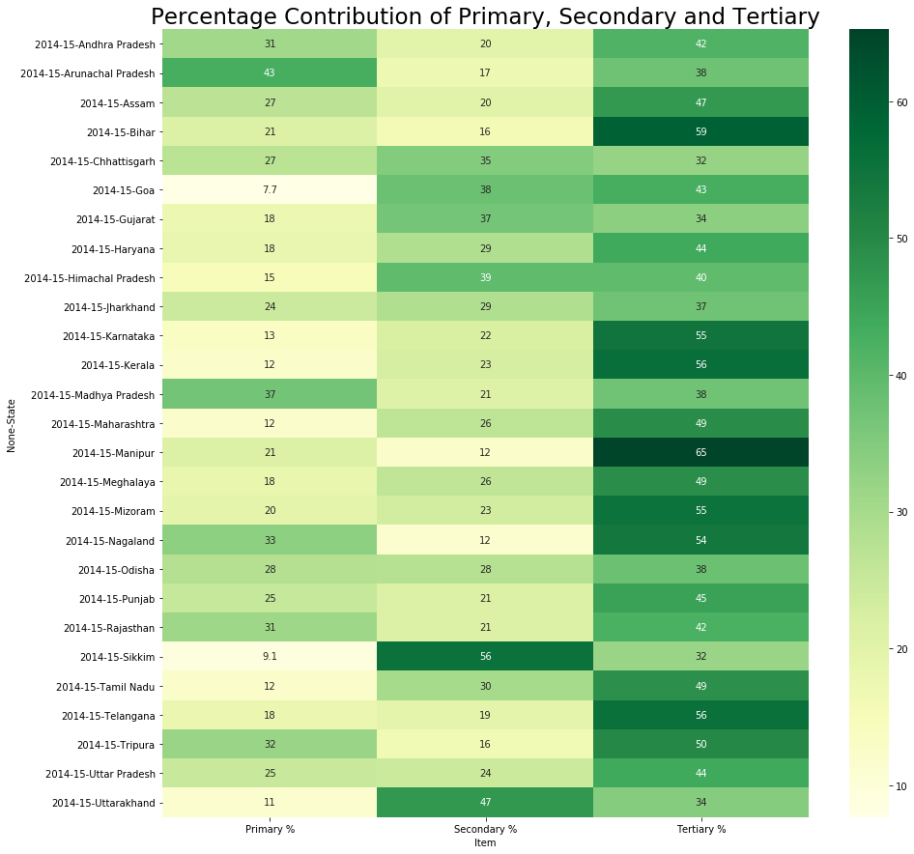
Percentage Contribution of Primary, secondary and Tertiary sectors across different states:-
In primary sector Arunachal Pradesh(43) has the highest contribution and Goa has the minimum(7.7) contribution.
In secondary sector Sikkim(56) has the highest contribution and Manipur with Nagaland (12) has the minimum contribution.
In tertiary sector Manipur(65) has the highest contribution and Chhattisgarh and Sikkim(32) has the minimum contribution.

Slide 14
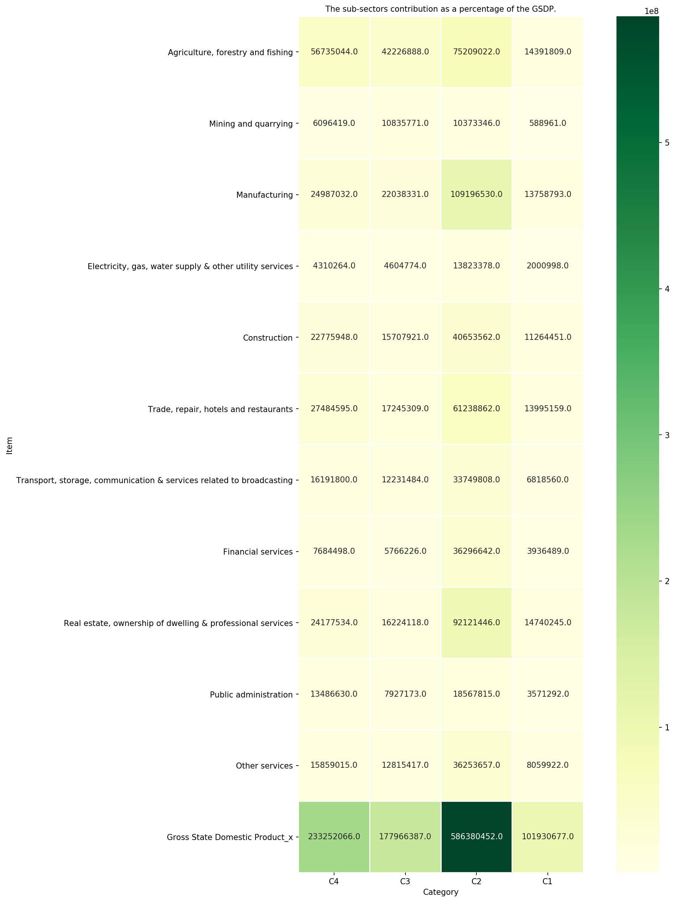
Sub-sector contribution in GSDP across all four categories:-
C1 category states has the minimum contribution. They need to work in ‘Mining and quarrying’ sub-sector for improvement.
C2 category states has the maximum contribution. But they have less contribution from the sub-sector ‘Mining and quarrying’.
C3 Category contribute below average but they need to work on sub-sector ‘Electricity, gas, water supply & other utility services’.
C4 Category contribute above average but they have to focus on sub-sector ‘Electricity, gas, water supply & other utility services’.

Slide 15
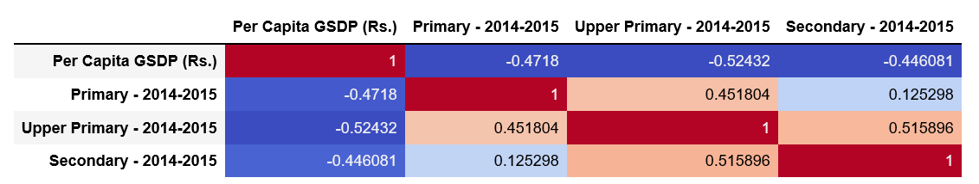
Correlation matrix of GDP per capita with dropout rates in education (primary, upper primary and secondary) for the year 2014-2015 :-
As we can see in the correlation matrix the dropout rate in Upper Primary is very less and slightly higher in upper Secondary.

Slide 16
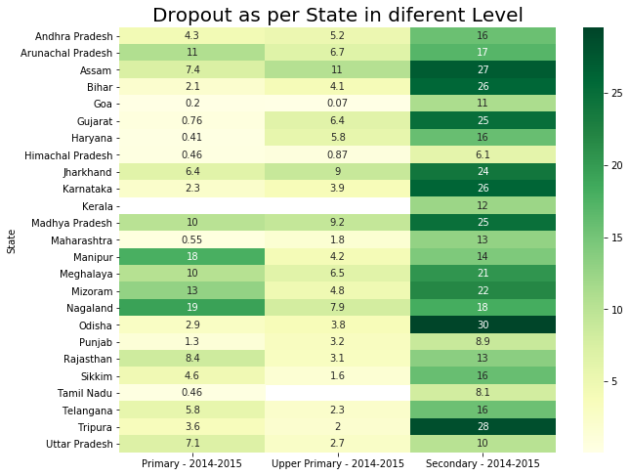

Slide 17
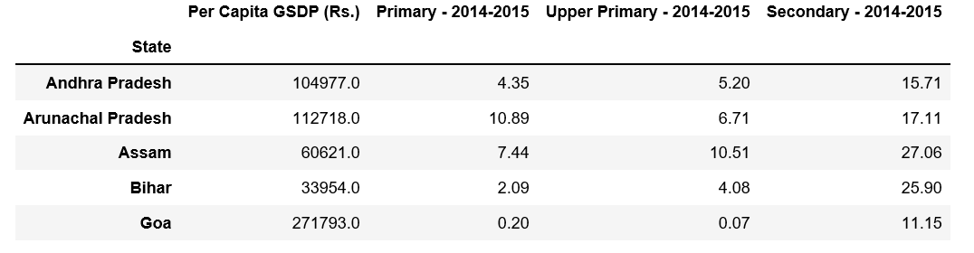
Drop out rate of some states are:-

Slide 18
RECOMMENDATION
We have to focus on Primary sectors because they have less rate in compare of all other three.
‘Mining and quarrying’ and ‘Electricity, gas, water supply & other utility services’ sub-sectors need more facility. So that they can improve in their respective areas and overall in state growth.
Provide proper guidance in people about the secondary level of education because most of students drop in secondary level which is not a good part of state growth.
As Uttar Pradesh having large number of population so we can increase the GDP per capita their very easily by provide work to the people which will surely increase the GDP of the state as well as of our country also.
As now in 2019 India is on 7th position in GDP across world so we have to focus on those state which have large no. of population so that we will get maximum output in lesser time.

